Slide 1
Physics 1 – Aug 21, 2018
P3 Challenge – Do Now (on slips of paper)
Express 22.5 m/s in mph using 2.54 cm = 1 in as the metric
to English conversion. Show all work.
Hand in syllabus verif.
Hand in safety contract
Show the 1.1 Worksheet for
Hmk check
Remember Label: Name, Date, Phys 1

Slide 2
Agenda
Agenda for IB 1.1 Measurement in physics – Standard operating procedures
About Numbers
Measuring
Significant figures
Scientific Notation
Calculations with sigfigs
Unit conversion
Assignment: IB 1.1 Measurement in Physics Practice Sheet, Estimates, Read 1.2
Homework Review, p 1-4
Standards
Metric units
Dimension Analysis
Estimation

Slide 3
Standards
Why need standards?
Consider a world without standards
Good standards
A) Unchanging over time and B) Accessible everywhere
Poor standards
Ex: “yard comes from the Saxon word "gird" meaning the circumference of a person’s waist” (National Institute Of Standards And Technology)
IUPAC (International Union of Pure and Applied Chemistry)
The world authority on chemical nomenclature, terminology, standardized methods for measurement, atomic weights and other critically evaluated data.

Slide 4
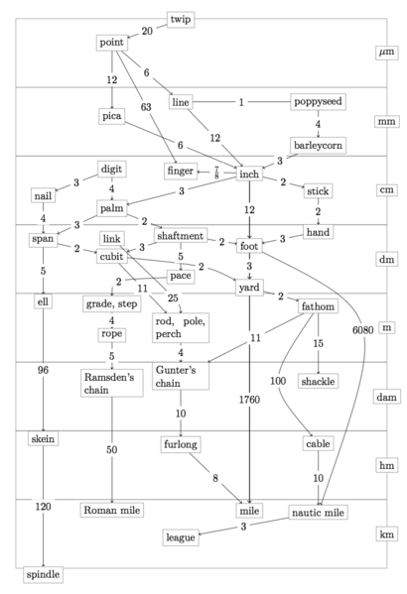
English System
Complex relationships between units
Historical standards are anecdotal
Current standards are defined in terms of SI units
Ex: 1 foot = exactly 0.3048 m
“Treaty of the Meter” 1875
Metric Conversion Act of 1975
“Preferred official system” 1988
2017, we’re still teaching English units

Slide 5
SI (or metric) System
Standard for time
1 second is defined as the duration of 9, 192, 631, 770 periods of the radiation (light) emitted from a certain transition in a cesium-133 atom. (Atomic clock)
Though Cs-133 is not available everywhere, and it is not simple to make this observation, every cs-133 atom would behave the same way.

Slide 6
SI (or metric) System
Standard for length
1 meter is defined as the distance that light travels in vacuum in 1/299,792,458 s.
Speed of light in a vacuum is a constant.
Available everywhere.
Depends on the standard of time.

Slide 7
SI (or metric) System
Standard for mass
1 kilogram is defined as the mass of a singular cylinder of a platinum alloy that is housed in Sèvres, France, called the IPK (international prototype kilogram)
K 20 (US official prototype) is a third generation copy – each copy of a copy level creates additional error, though very small
Pt chosen because it does not decay over time, so it is a relatively stable standard.
https://www.youtube.com/watch?v=ZMByI4s-D-Y World’s Roundest Object
IPK
K20

Slide 8
SI (metric) System
DERIVED UNITS
Units for all other quantities besides the base
For each new quantity we will discuss, we will learn about:
Name of the quantity (Ex: Force)
Symbol used to represent the quantity (Ex: F)
Name of unit used to measure the quantity (Ex: Newton)
Symbol for the unit (Ex: N)
The unit expressed in base units (Ex: 1 N = 1 kg m s⁻² )
BASE UNITS (all defined relative to the 3 standards above)
meter for length
kilogram for mass (note: not the gram)
second for time
ampere for electric current
kelvin for temperature
candela for luminous intensity
mole for the amount of substance

Slide 9
Metric Conversions
PREFIXES
Allows units to be a convenient size for observations
Defined in terms of powers of 10
Common Prefixes to memorize
Ways to Convert:
Prefix unit to base unit –
Replace prefix symbol with power of 10
Ex: 540 nm = 540 x 10⁻⁹ m
Move the decimal place
Often used with 3 orders of magnitude changes.
Ex: 45.6 mL = 0.0456 L
Factor Label methods using:
# in meter stick: 1 m = 10³ mm
Definition: 1 mm = 10⁻³ m
Prefix | Abbreviation | Power of 10
Nano- | n | 10⁻⁹
Micro- | ❍ | 10⁻⁶
Milli- | m | 10⁻³
Centi- | c | 10⁻²
Kilo- | k | 10³

Slide 10
Metric Conversions using prefixes
“Times sign, draw the line, copy the unit.”
The metric prefixes help you write conversion factors with the power of powers of 10!
Conversions to and from meters:
To create equivalences, replace the prefix of a metric unit name with the corresponding power of 10.
Ex: 1 km =10³ m; 1 pm = 10⁻¹² m or 1 m = 10¹² pm
Conversions between other metric units:
Convert to meters first and then to the target unit.
Ex: km to cm

Slide 11
Dimension Analysis
In physics, problems are often solved with the benefit of a formula that relates some number of quantities.
The units for any formula must be consistent.
Be able to verify the units for any formula by expressing all derived units in terms of base units.
Ex: Knowing that Energy (E) is measured in Joules (J = kg m² s⁻²), mass (m) is measured in kg, acceleration (a) is measured in m s⁻², and distance (d) is measured in m, Verify that E = mad is a valid formula to use to describe the relationships between these variables.

Slide 12
Estimation
Another common skill for any physics problem is to estimate the order of magnitude for your answer so you can judge whether your calculated answer is reasonable or not.
To estimate, Round all quantities to (one sig fig with an order of magnitude)
https://www.youtube.com/watch?v=0fKBhvDjuy0 Powers of 10
https://www.youtube.com/watch?v=jfSNxVqprvM Cosmic Eye
Perform the needed calculation using your new simple numbers to find a one sigfig order of magnitude estimate of the answer.
Ex: The wavelength of visible light is between 430 nm and 770 nm and the speed of light is 3.00 x 10⁸ m/s. If the speed = frequency * wavelength, estimate the order of magnitude for the frequency of visible light.

Slide 13
Exit Slip and Today’s Assignment
Exit Slip – Estimate the area (m²) available to each person if there are around 7 ½ billion people and the earth has a radius of around 5000 km. Give a one sigfig order of magnitude estimate. Then describe this area in terms of the images shown in the videos.
What’s Due? (Pending assignments to complete.)
IB 1.1 Measurement in Physics Practice Sheet, Estimation questions
What’s Next? (How to prepare for the next day)
Read IB 1.2 p 7-20

